Slide 1

DIABETES PREDICTION
Presented by D. BHUVANESHWAR, S. DEEPAK and G. ANISHKUMAR of I BSC CS
Under the guidance of
Dr Monika G
Head & Assistant Professor
Department of Computer science & Applications
Jeppiaar College of arts and Science
Padur, Chennai

Slide 2

"Diabetes is not a choice, but managing it is."
INTRODUCTION
Diabetes is a noncommunicable chronic disease that disrupts the body’s natural blood glucose concentration management with disorders of carbohydrate, fats, and protein metabolism due to imperfections in insulin secretion
Diabetes can lead to heart disease, stroke, kidney failure, blindness, and lower-limb amputation.
There are about 422 million people worldwide have diabetes.
In recent days type 1 diabetics is increasing because of the early introduction of cows milk, short duration of breastfeeding ,and perhaps even pollution.

Slide 3
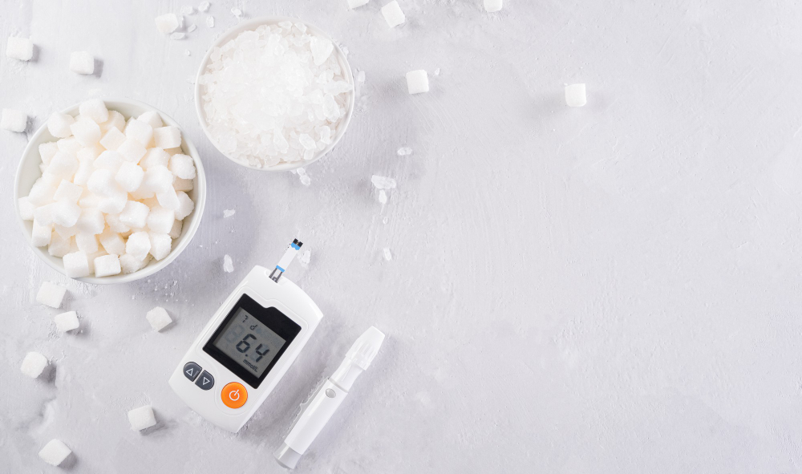
EXISTING RESEARCH
Why it is high in India?
We are experiencing several environment and lifestyle changes because of industrialization , migration to urban areas, rising per capita spending, and a culture of eating out.
In India tamilnadu has the 6th highest diabetes rate at about 16%.
Various prediction models have been developed and implemented by various researchers using variants of data mining techniques, machine learning algorithms.
Actually, machine learning techniques have been widely used in healthcare systems to make decisions based on clinical data . In this context, many researchers have used them for the diagnosis of diabetes.
"Diabetes doesn't define me; I define how I manage it."

Slide 4

SOCIAL CAUSE /PROBLEM
"Living with diabetes requires strength, resilience, and determination."
“OUR INDIA WILL BECOME A DIABETESSLESS COUNTRY”
To bring our country’s diabetes rate to nil, this project was done to analyse the causes for the diabetes.
There are many things that is being the cause of diabetes from that we are finding the critical and mostly strong cause for diabetes.

Slide 5
Icons
PROPOSED PROJECT WORK
Proposed AI tools to be used in the project:
WEKA
WEKA is a software which has a collection of machine learning algorithms for certain data mining tasks.
In this project, random tree algorithm and Navies bayes algorithm is used. It is used for classification and regression problems in machine language.
Flow chart of proposed work:
Preprocessing
Diabetes Dataset
Classiification Algorithm
Results

Slide 6

PROPOSED PROJECT WORK
"Diabetes is a challenge, but I won't let it hold me back."
Data are collected from the open source website. The dataset is taken from the Kaggle website.
KAGGLE is a open source data website to collect a set of Data and Information. It is based on data science and artificial intelligence platform.
This data consists of 9 attributes and consists of over 3000 + data. We have taken only 750 data from that for our analysis part.
Our Data set contains about diabetic history of people who are all having which is based on the gender age hypertension, heart disease ,smoking habit, BMI and blood glucose level.

Slide 7
How To Edit Shapes
PROPOSED PROJECT WORK
You can add and edit some shapes to your presentation to present your data in a visual way.
The diabetes dataset was applied in the Weka tool.
Then dataset is checked for null values and removed.
Then numeric data is converted to Nominal data using preprocessing phase in the weka tool.
Then the classification phase comes- Random forest algorithm and Navies bayes algorithm was applied.
Then the results are noted. Some of the results are in visualized form as graphs.
Choose your favourite infographic and insert it in your presentation using Ctrl C + Ctrl V or Cmd C + Cmd V in Mac.
Select one of the parts and ungroup it by right-clicking and choosing “Ungroup”.
Change the color by clicking on the paint bucket.
Then resize the element by clicking and dragging one of the square-shaped points of its bounding box (the cursor should look like a double-headed arrow). Remember to hold Shift while dragging to keep the proportions.
Group the elements again by selecting them, right-clicking and choosing “Group”.
Repeat the steps above with the other parts and when you’re done editing, copy the end result and paste it into your presentation.
Remember to choose the “Keep source formatting” option so that it keeps the design. For more info, please visit Slideegg (Tips & Tricks).

Slide 8
How To Edit Shapes
Results Discussion
You can add and edit some shapes to your presentation to present your data in a visual way.
Random Forest Algorithm: Random Forest is a popular machine learning algorithm that belongs to the supervised learning technique. It can be used for both Classification and Regression
Naïve Bayes algorithm is a supervised learning algorithm, which is based on Bayes theorem and used for solving classification problems.
Evaluation metrics: AccuracyIt is the ratio of the number of correct predictions to the total number of predictions made for a dataset.,
Accuracy= TP+TN/ TP+FP+TN+FN
PRECISION:It is the ratio of True Positives to all the positives predicted by the model
Precision=TP/TP+FP
Choose your favourite infographic and insert it in your presentation using Ctrl C + Ctrl V or Cmd C + Cmd V in Mac.
Select one of the parts and ungroup it by right-clicking and choosing “Ungroup”.
Change the color by clicking on the paint bucket.
Then resize the element by clicking and dragging one of the square-shaped points of its bounding box (the cursor should look like a double-headed arrow). Remember to hold Shift while dragging to keep the proportions.
Group the elements again by selecting them, right-clicking and choosing “Group”.
Repeat the steps above with the other parts and when you’re done editing, copy the end result and paste it into your presentation.
Remember to choose the “Keep source formatting” option so that it keeps the design. For more info, please visit Slideegg (Tips & Tricks).
Evaluation metrics/ Classifier | PRECISION | ACCURACY
Random forest | 65% | 63%
Navies bayes | 85% | 85%
According to the above results the Navies bayes shows good results and precision value compared to the Random forest values. So diabetes prediction is more accurate by Navies bayes algorithm

Slide 9
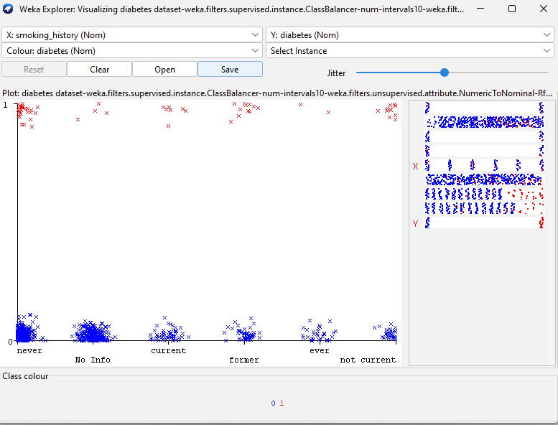
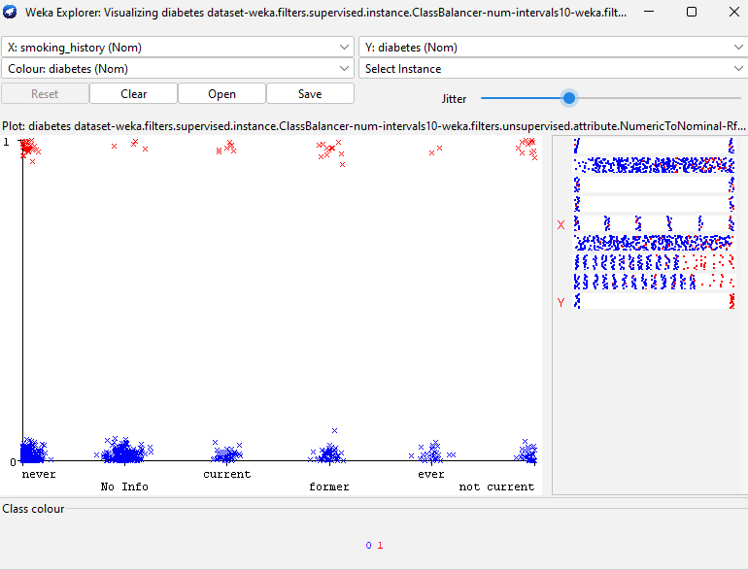
Results Discussion
How To Edit Shapes
In the below graph we have Random forest result and navies bayes result x: smoking history y: diabetes
Red color: diabetes
Blue color: no diabetes
This shows the smoking history of a person also one of the strong cause to get diabetes soon
You can add and edit some shapes to your presentation to present your data in a visual way.
Choose your favourite infographic and insert it in your presentation using Ctrl C + Ctrl V or Cmd C + Cmd V in Mac.
Select one of the parts and ungroup it by right-clicking and choosing “Ungroup”.
Change the color by clicking on the paint bucket.
Then resize the element by clicking and dragging one of the square-shaped points of its bounding box (the cursor should look like a double-headed arrow). Remember to hold Shift while dragging to keep the proportions.
Group the elements again by selecting them, right-clicking and choosing “Group”.
Repeat the steps above with the other parts and when you’re done editing, copy the end result and paste it into your presentation.
Remember to choose the “Keep source formatting” option so that it keeps the design. For more info, please visit Slideegg (Tips & Tricks).
Navies bayes
Random Forest

Slide 10
FUTURE WORK
How To Edit Shapes
You can add and edit some shapes to your presentation to present your data in a visual way.
Choose your favourite infographic and insert it in your presentation using Ctrl C + Ctrl V or Cmd C + Cmd V in Mac.
Select one of the parts and ungroup it by right-clicking and choosing “Ungroup”.
Change the color by clicking on the paint bucket.
Then resize the element by clicking and dragging one of the square-shaped points of its bounding box (the cursor should look like a double-headed arrow). Remember to hold Shift while dragging to keep the proportions.
Group the elements again by selecting them, right-clicking and choosing “Group”.
Repeat the steps above with the other parts and when you’re done editing, copy the end result and paste it into your presentation.
Remember to choose the “Keep source formatting” option so that it keeps the design. For more info, please visit Slideegg (Tips & Tricks).
Here we have analysed the existing dataset so we can extend our project by adding more attributes and implement it in python or R studio with real time dataset from healthcare industry

Slide 11
THANK YOU!

